Slide 1
July 1st Update

Slide 2
Charged Pion Reconstruction Efficiency by KE
Dlgen2 Ntuple Files with 150k entries
37,314 pions (27908 CC, 9406 NC)
Pion reco efficiency by true KE
Filter by final state particles
Track with highest completeness
Scaled to 6.67e20 POT

Slide 3
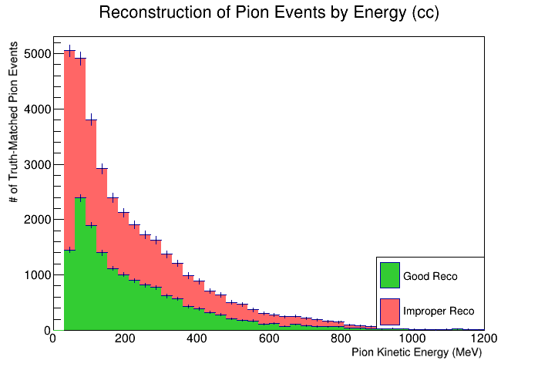
25709 visible pions total (30 MeV or above)
11270 reconstructed
14439 improper reco
~ 43.8% efficiency
Low efficiency for 30-60 MeV

Slide 4
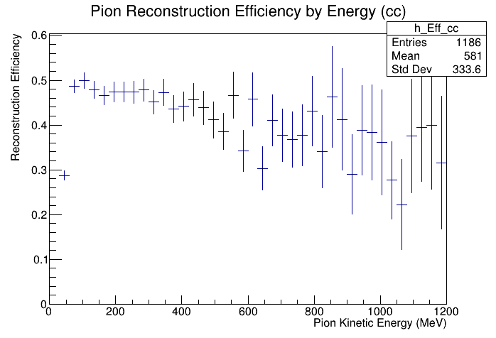
25709 visible pions total (30 MeV or above)
11270 reconstructed
14439 improper reco
~ 43.8% efficiency
Low efficiency for 30-60 MeV

Slide 5
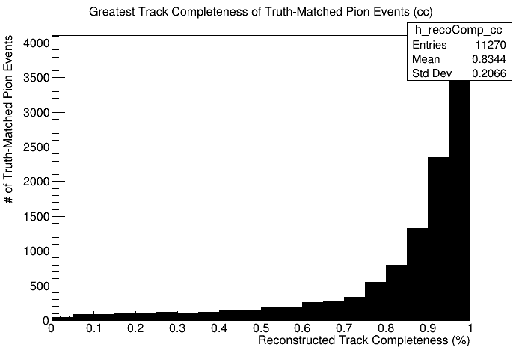
25709 visible pions total (30 MeV or above)
11270 reconstructed
14439 improper reco
~ 43.8% efficiency
If successfully reconstructed, will capture most of the pion

Slide 6

Muons 30 MeV or above
24864 visible pions total (30 MeV or above)
10942 reconstructed
13922 improper reco
~ 44% efficiency

Slide 7
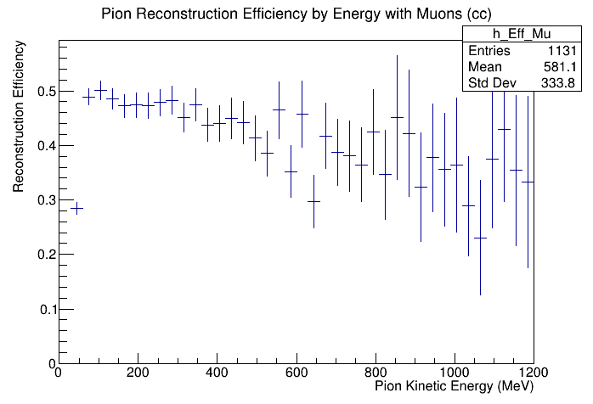
Muons 30 MeV or above
24864 visible pions total (30 MeV or above)
10942 reconstructed
13922 improper reco
~ 44% efficiency

Slide 8

Muons 30 MeV or above
24864 visible pions total (30 MeV or above)
10942 reconstructed
13922 improper reco
~ 44% efficiency

Slide 9
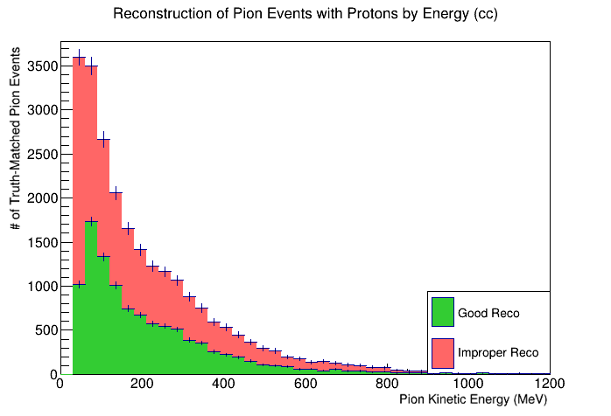
Protons 60 MeV or above
17009 visible pions total (30 MeV or above)
7415 reconstructed
9594 improper reco
~ 43.6% efficiency

Slide 10
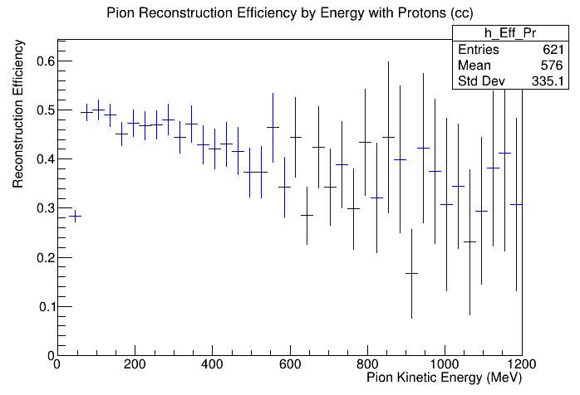
Protons 60 MeV or above
17009 visible pions total (30 MeV or above)
7415 reconstructed
9594 improper reco
~ 43.6% efficiency

Slide 11
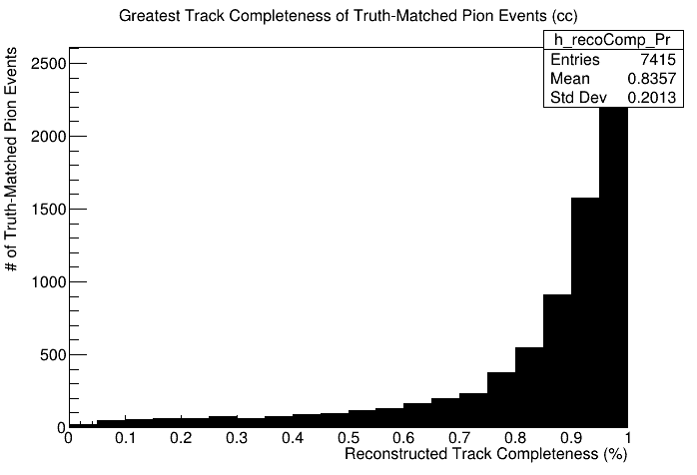
Protons 60 MeV or above
17009 visible pions total (30 MeV or above)
7415 reconstructed
9594 improper reco
~ 43.6% efficiency

Slide 12
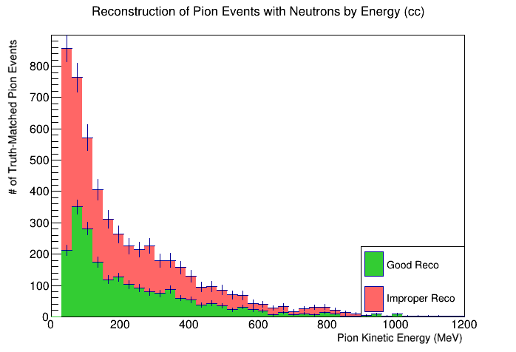
Neutrons 60 MeV or above
3781 visible pions total (30 MeV or above)
1521 reconstructed
2260 improper reco
~ 40.2% efficiency

Slide 13
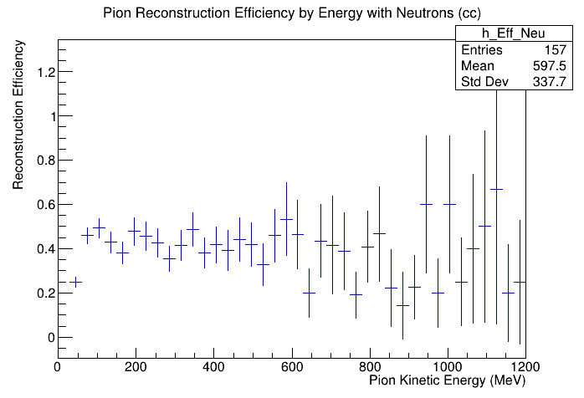
Neutrons 60 MeV or above
3781 visible pions total (30 MeV or above)
1521 reconstructed
2260 improper reco
~ 40.2% efficiency

Slide 14

Neutrons 60 MeV or above
3781 visible pions total (30 MeV or above)
1521 reconstructed
2260 improper reco
~ 40.2% efficiency

Slide 15
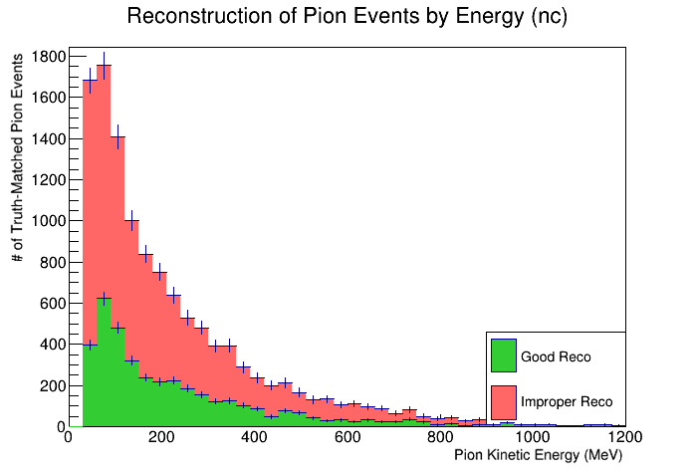
8658 visible pions total (30 MeV or above)
2732 reconstructed
5926 improper reco
~ 31.6% efficiency

Slide 16
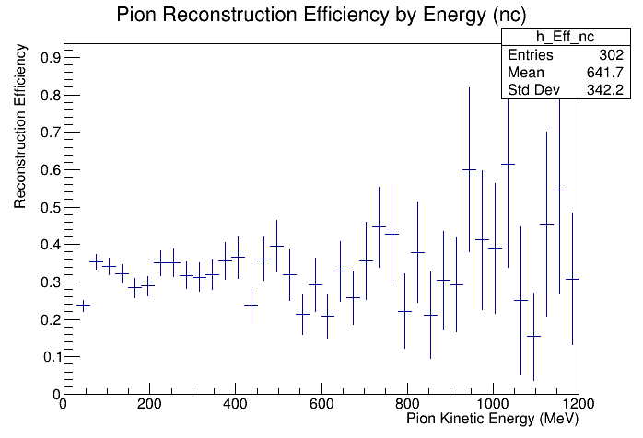
25709 visible pions total (30 MeV or above)
11270 reconstructed
14439 improper reco
~ 43.8% efficiency

Slide 17

25709 visible pions total (30 MeV or above)
11270 reconstructed
14439 improper reco
~ 43.8% efficiency
If successfully reconstructed, will capture most of the pion

Slide 18
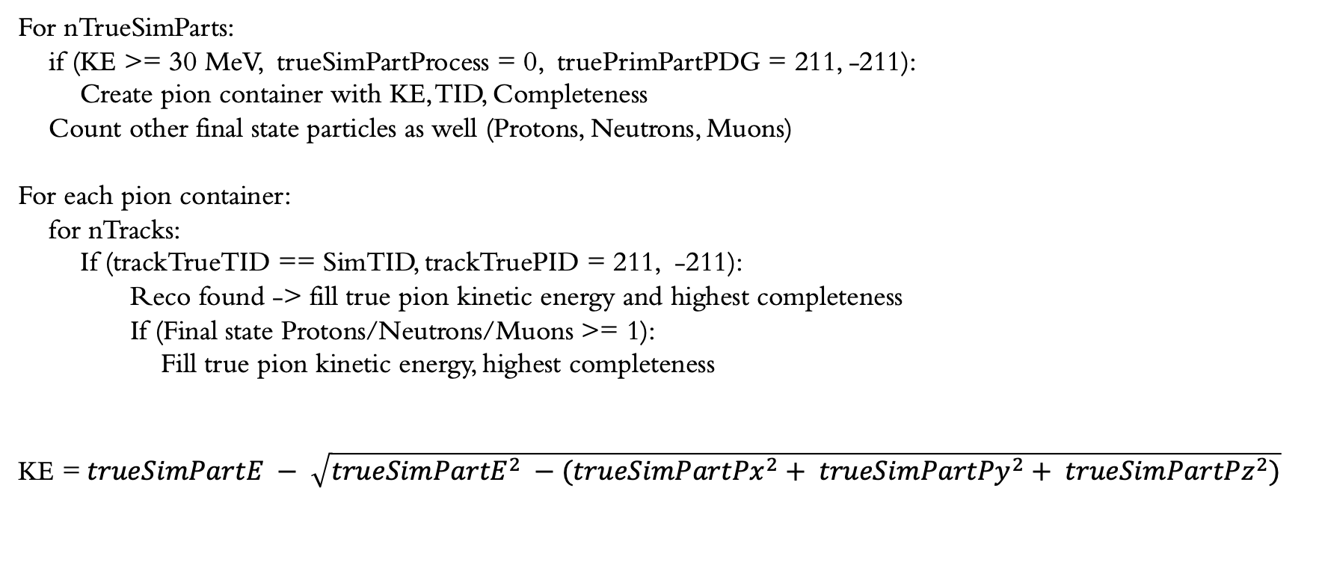
Pseudo-code for Reco Efficiency
For nTrueSimParts:
if (KE >= 30 MeV, trueSimPartProcess = 0, truePrimPartPDG = 211, -211):
Create pion container with KE, TID, Completeness
Count other final state particles as well (Protons, Neutrons, Muons)
For each pion container:
for nTracks:
If (trackTrueTID == SimTID, trackTruePID = 211, -211):
Reco found -> fill true pion kinetic energy and highest completeness
If (Final state Protons/Neutrons/Muons >= 1):
Fill true pion kinetic energy, highest completeness
KE =$trueSimPartE − \sqrt{{trueSimPartE}^{2} −({trueSimPartPx}^{2}+ {trueSimPartPy}^{2}+ {trueSimPartPz}^{2})}$

Slide 19
Causes of Improper Reconstruction
Existing track, misidentified PDG
Missing track
Misidentified as secondary
No trace at all

Slide 20
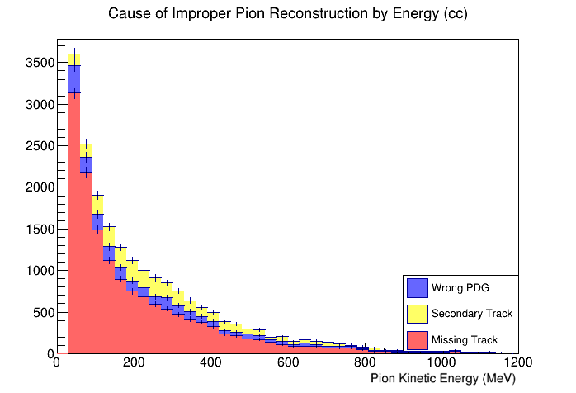
14439 improperly reconstructed pions
1620 mis-ID PDG
2338 mis-ID as Secondary
10481 missing altogether

Slide 21
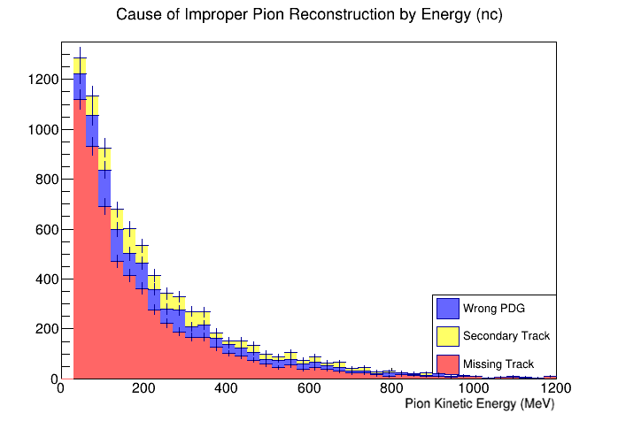
5926 improperly reconstructed pions
970 mis-ID PDG
780 mis-ID as Secondary
4176 missing altogether

Slide 22
Pseudo-code for Improper Reco types
For nTrueSimParts:
if (KE >= 30 MeV, trueSimPartProcess = 0, truePrimPartPDG = 211, -211):
Create pion container with KE, TID, Completeness
Add to container Boolean variables TID_found, reco_found, primary_found = false
Count other final state particles as well (Protons, Neutrons, Muons)
For each pion container:
for nTracks:
recursively find ancestor primary with trueSimPartMID and trueSimPartProcess
if (TID_found == true AND reco_found == false):
incorrect PDG, fill true pion kinetic energy
else if (primary_found == true):
misidentified as secondary, fill true pion kinetic energy
else:
missing track, fill true pion kinetic energy

Slide 23
Next Steps
Further calculate efficiency by number of final state particles
Further investigation of missing pion tracks:
Find most colinear primary to missing pions
Test reconstruction efficiency when ignoring track scores of certain PDGs (e.g. trackMuScore)

